Slide 1
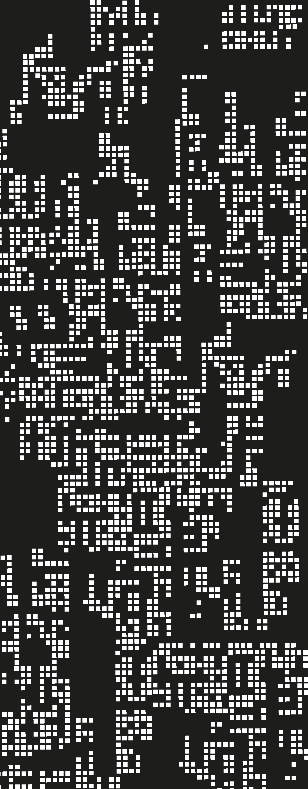
Recursion
2. Y combinator

Slide 2
Agenda
01
The doubt on Church and Turing
02
Omega Expression
03
Y combinator

Slide 3
How do we implemented recursion?
Through mutation.

Slide 4
How to create a recursive environment?
So, how do we usually solve it? Let’s look at OOP
A = new A( new B (...))
Use null value
a = new A (null)
b = new B (a)
a.setB(b) ← Mutation!
So, chicken and egg situation is simple to solve in a world with mutation
E. Tanter

Slide 5
How to apply this logic?
We will use these same three phases.
sum
(incomplete-env)
Associate function with an incomplete environment.
(interp ne (incomplete-env))
Mutate and put the right reference.
We end up with a cyclic environment
sum
(incomplete-env)
(closureV n (if …))
sum
(incomplete-env)
(closureV n (if …) )

Slide 6
How do we implemented recursion?
We implemented a cyclic environment for the function to know its own existence
But, is mutation ok in functional languages?
Nope, mutation means problems, but there is a bigger issue round here.

Slide 7
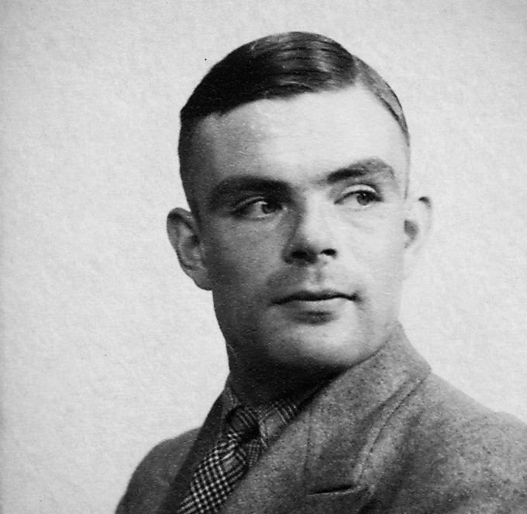
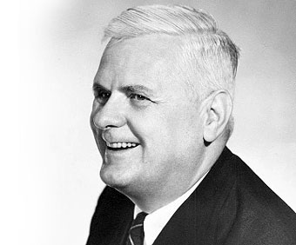
The doubt on Church and Turing
So, let’s remember Lambda Calculus, does it support mutation?
No, but does that mean that it does not support recursion? That is worrying, because without recursion, LC would NOT be Turing complete and Church-Turing’s thesis would be wrong!

Slide 8
Is mutation mandatory?
So, can a program run infinitely? Well, that is what recursion is about. But can there be a way of implementing recursion without using mutation?
So, recursion comes from applying functions. Can I make a function to apply itself infinitely?
{{fun {x} {x x}} {fun {x} {x x}}}

Slide 9
The omega term
So, this lovely expression is a function that applies itself. Take a look on this, can it run eternally?
Try to execute it!. The function is self-applying, so it represents a while true, an infinite loop.
News! It is recursive, but it does not uses rec.
{{fun {x} {x x}} {fun {x} {x x}}}

Slide 10
Can we use the same idea?
Let’s go back to our sum function, if it does not know its own existence, we could pass the same function as an argument
(run '{with {sum {fun {sum}
{fun {n}
{if-tf {zero?? n}
0
{+ n {sum {- n 1}}}}}}}
{sum 10}}))

Slide 11
Can we use the same idea?
Now sum is a function that receives a function as input, and then this function receives the number. Let’s update the sum calls.
(run '{with {sum {fun {sum}
{fun {n}
{if-tf {zero?? n}
0
{+ n {{sum sum} {- n 1}}}}}}}
{{sum sum} 10}}))

Slide 12
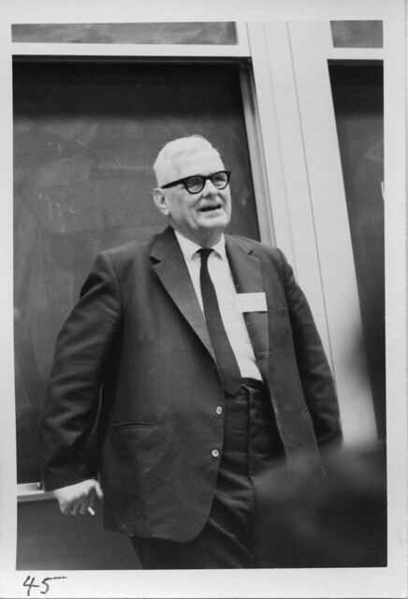

The doubt on Church and Turing
Great! It is possible to have recursion without mutation!
Using just the constructs of LC, variables, functions and function applications, we can define recursive functions.
So Church and Turing were not wrong!

Slide 13
Can we abstract this?
So, we have a way of supporting recursion without having special constructs or using mutation. But, this way is not comfortable right?
Writing functions twice seems weird, luckily for us, it can be abstracted using lambdas!
(run '{with {sum {fun {sum}
{fun {n}
{if-tf {zero?? n}
0
{+ n {{sum sum} {- n 1}}}}}}}
{{sum sum} 10}}))

Slide 14
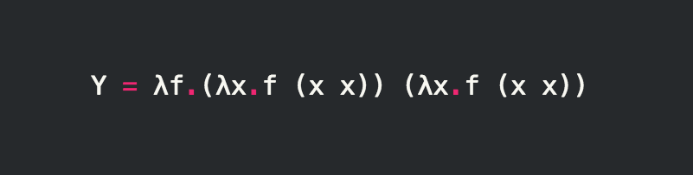
The Y combinator
The Y combinator is a way of providing recursion via a higher order function that takes a function as input.

Slide 15
The Y combinator
{fun {f}
{with {h {fun {g}
{fun {n}
{{f {g g}} n}}}}
{h h}}}
In our language, we can define it this way:
And use it this way
(run '{with {Y {fun {f}
{with {h {fun {g}
{fun {n}
{{f {g g}} n}}}}
{h h}}}}
{with {sum {Y {fun {sum}
{fun {n}
{if-tf {zero?? n}
0
{+ n {sum {- n 1}}}}}}}}
{sum 10}}})

Slide 16
The Y combinator
So, this allows us to not use mutation, and only use Y combinator as a function in our environment. Therefore, rec can be implemented as syntax sugar.
Your task? Implement it!

Slide 17
Summary
References
Recursion can be implemented without mutation. Without any change, just using the beauty of the lambdas abstraction.
PLAI, Chapter 8, 9.
A note on Recursion - E.Tanter
The Why of Y - R. Gabriel

